Slide 1
TCP on Tokamak Programmes (CTP TCP)
Shunsuke IDE
Paris, France, 16-17 February 2026, IEA FUSION POWER CO-ORDINATING COMMITTEE (FPCC)

Slide 2
Outline
Objectives
Membership
Participation of the private sector: Limited Sponsors
Meetings
CICLOP: A Joint Task of the Co-operation between CTP (Tokamak) and SH (Stellarator) TCP
Highlights

Slide 3
Objectives
Advance the physics and technologies related to toroidal plasmas.
Strengthening cooperation among tokamak programmes, enhancing the effectiveness and productivity of the research and development (R&D) effort related to the tokamak fusion concept.
Contributing to and extending the scientific and technology database of toroidal confinement concepts and providing a scientific and technological basis for the successful development of fusion power.
Provide a framework for the International Tokamak Physics Activities (ITPA), related topical group meetings, workshops and joint experiments.

Slide 4










Membership
CTP TCP has 10 Contracting Parties (CPs) 6 IEA member countries:
Australian Nuclear Science and Technology Organisation (ANSTO), Australia
National Institutes for Quantum and Radiological Science and Technology (QST), Japan
Korean Ministry of Education, Science and Technology (MEST), Korea
United States Department of Energy (USDOE), United States
Ecole polytechnique fédérale de Lausanne (EPFL), Switzerland
Government of the United Kingdom, United Kingdom
1 partner country:
The Institute for Plasma Research (IPR), India
3 International Organizations:
European Atomic Energy Community (Euratom), European Union
ITER China Domestic Agency (CNDA)
ITER Organization

Slide 5

Membership
The CTP TCP Executive Committee took note of the proposal to invite Kazakhstan to become a member of the CTP TCP and formal approval will be carried out via a written procedure ending on 27/2/2026.

Slide 6


Participation of the private sector: Limited Sponsors
The Executive Committee of the CTP TCP, via a Written Procedure that ended on 14th February 2025, unanimously approved the proposal to invite Commonwealth Fusion Systems (CFS) based in the United States (US) to Join the CTP TCP as a Limited Sponsor. The participation of Commonwealth Fusion Systems based in the United States (US) as a Limited Sponsor to the CTP TCP became effective as of 19th April 2025.
⇒ This enabled CFS to participate ITPEA (formerly known as ITPA). CFS researchers participated to meetings of several ITPEA Topical Groups.
At the 16th CTP TCP Executive Committee meeting, the CTP TCP Executive Committee unanimously approved the proposal for the Chinese company ENN Science and Technology Development Co., Ltd. (ENN) to become a Limited Sponsor to the CTP TCP.

Slide 7
Meetings
16th Executive Committee Meeting at the ITER Organisation Headquarters, St. Paul-lez-Durance, France, Friday 5th December 2025.
28th meeting of the International Tokamak Physics Activity Coordinating Committee (ITPA CC) and 16th ITPA meeting for Joint Experiments at the ITER Organisation Headquarters, St. Paul-lez-Durance, France, 3th-5th December 2025.

Slide 8
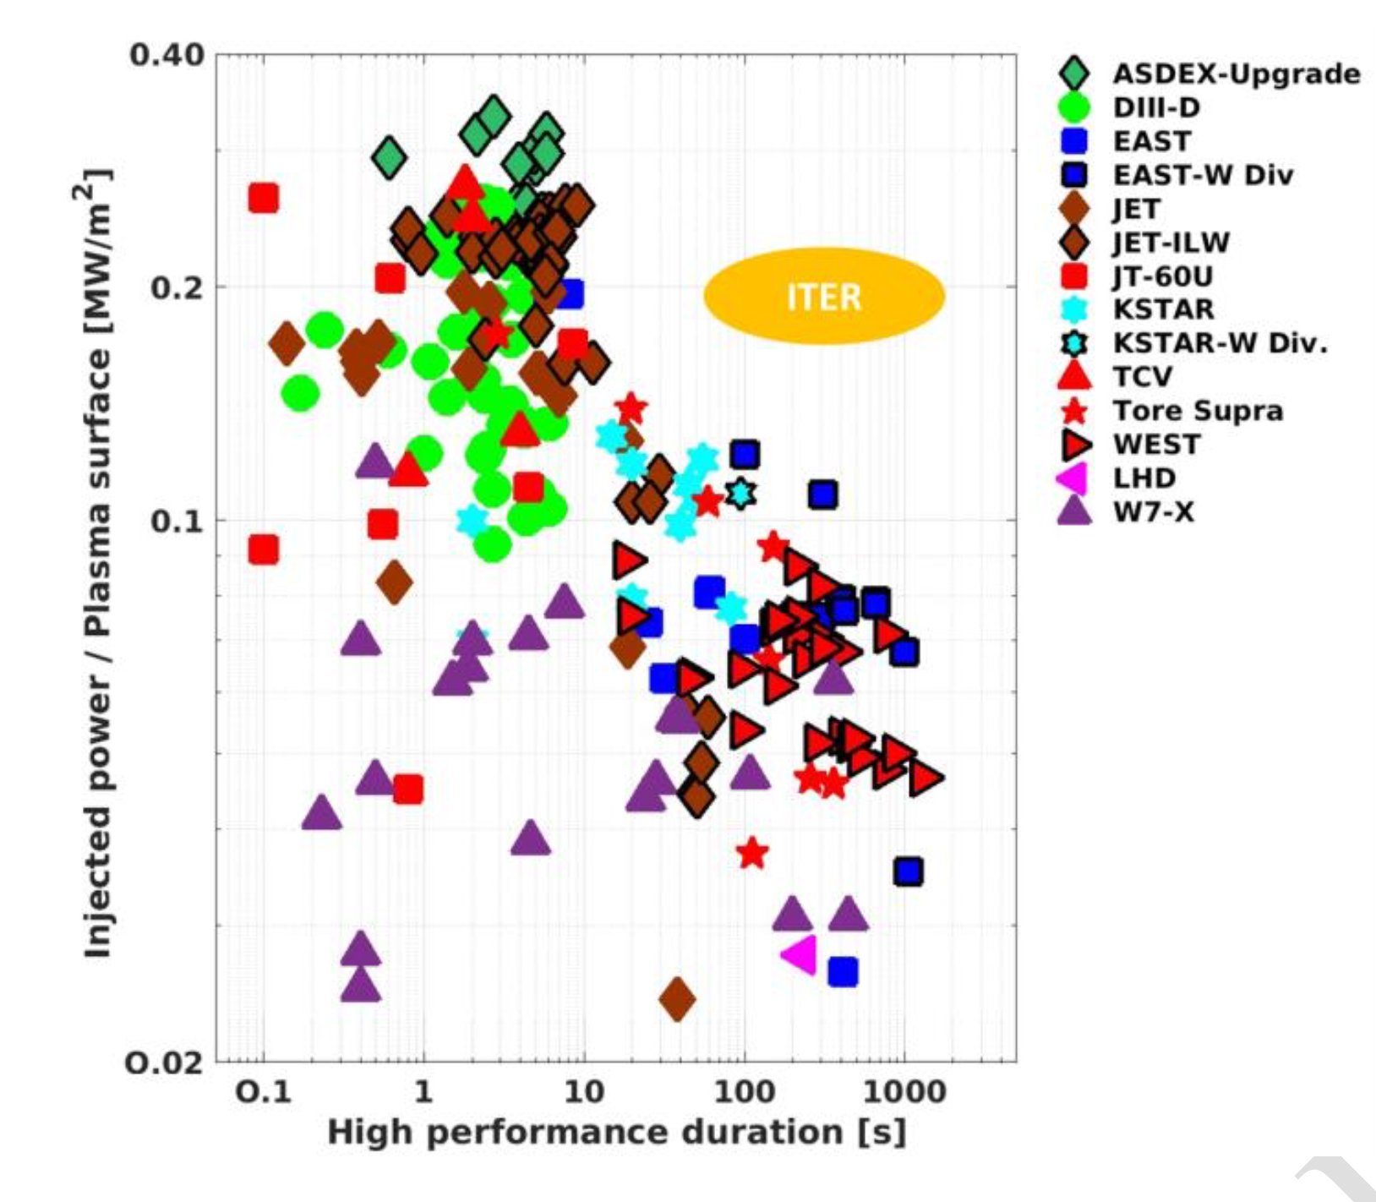
CICLOP: A Joint Task of the Co-operation between CTP and SH
The CICLOP Joint Task between the Co-operation on Tokamak Programmes (CTP) and Stellarators and Heliotrons (SH) Technology Collaboration Programmes (TCPs) was established in 2024.
Significant progress has been made in tokamaks and stellarators including very recent achievements in the duration and performance, supported by the use of superconducting coils, actively cooled components, and various types of metallic walls.

Slide 9
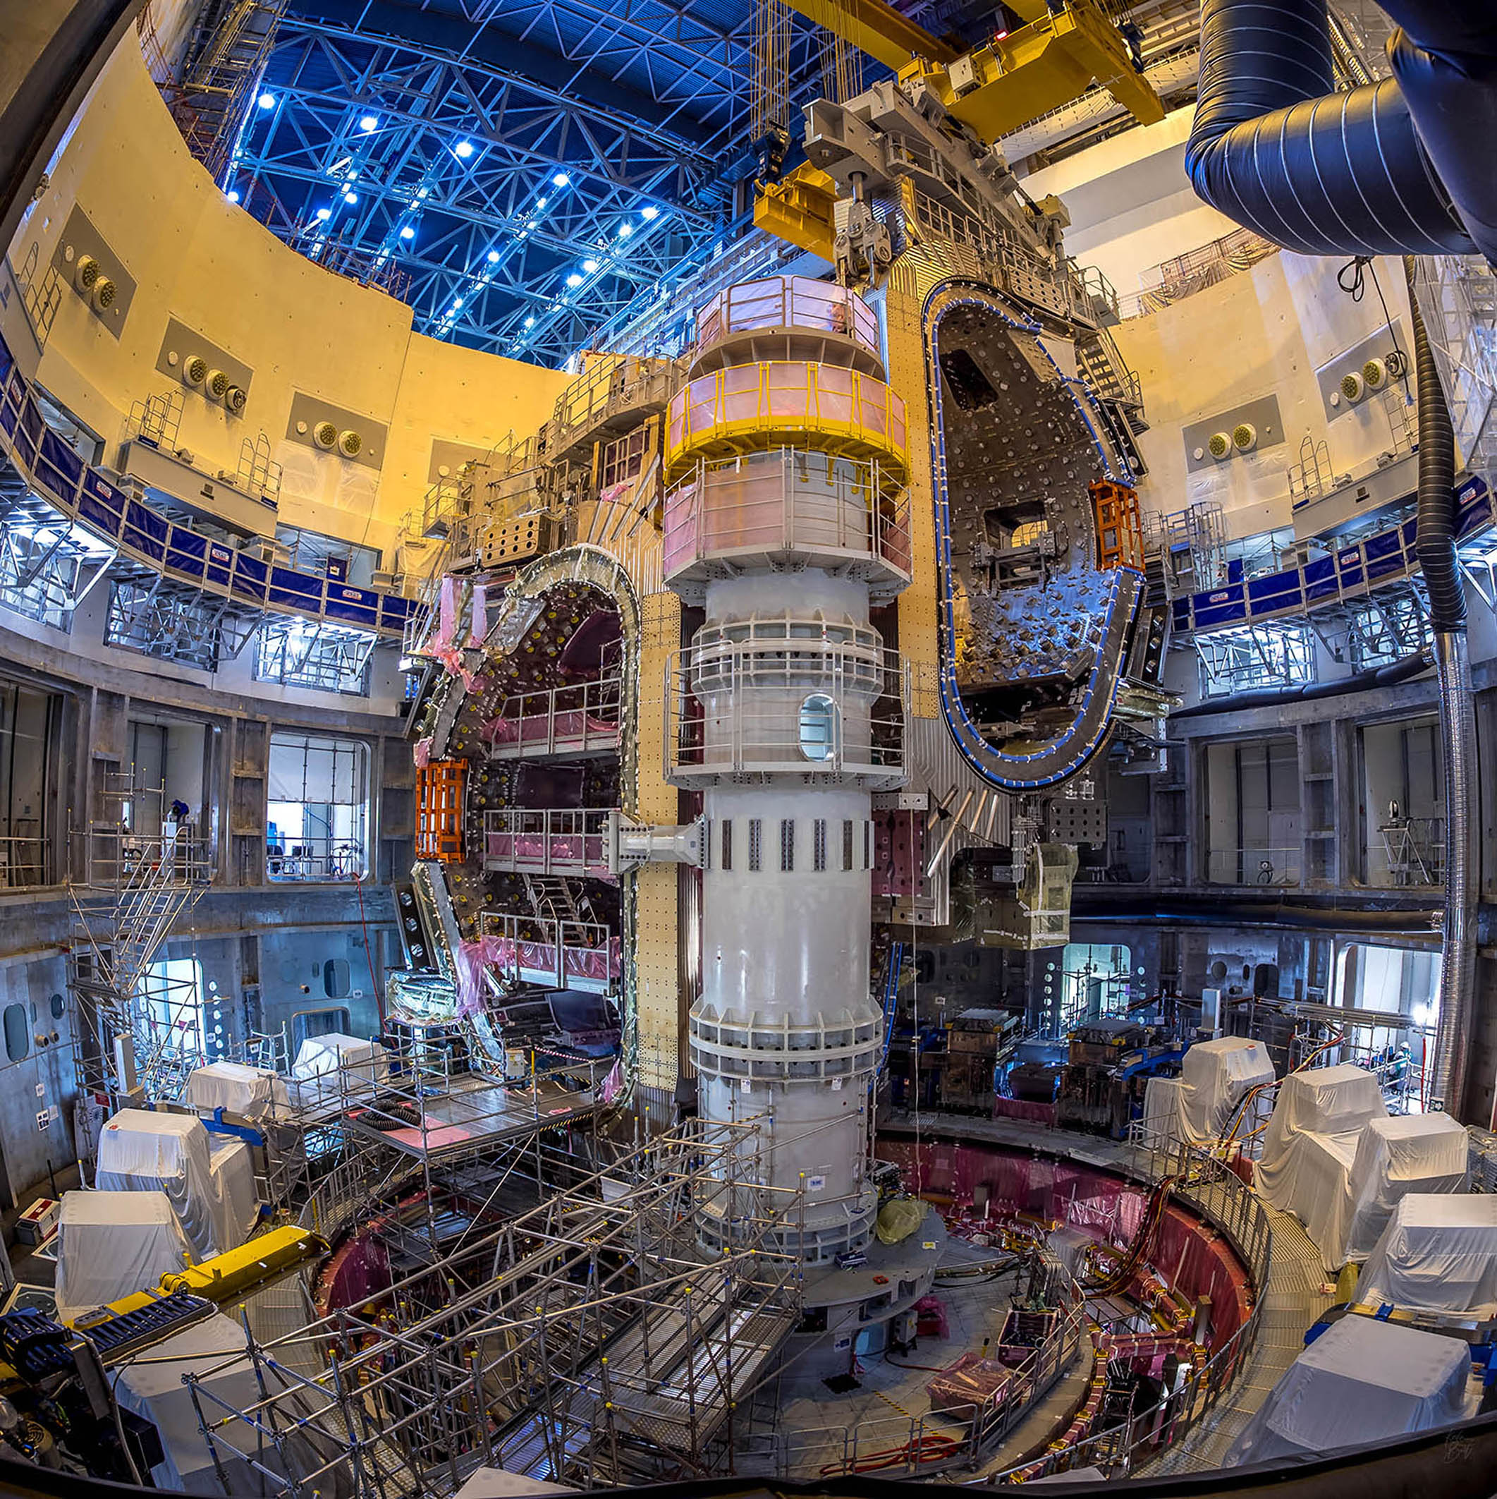
Highlights
The ITER project has continued making steady progress towards first plasma and the respective sector module sub assembly have started.

Slide 10
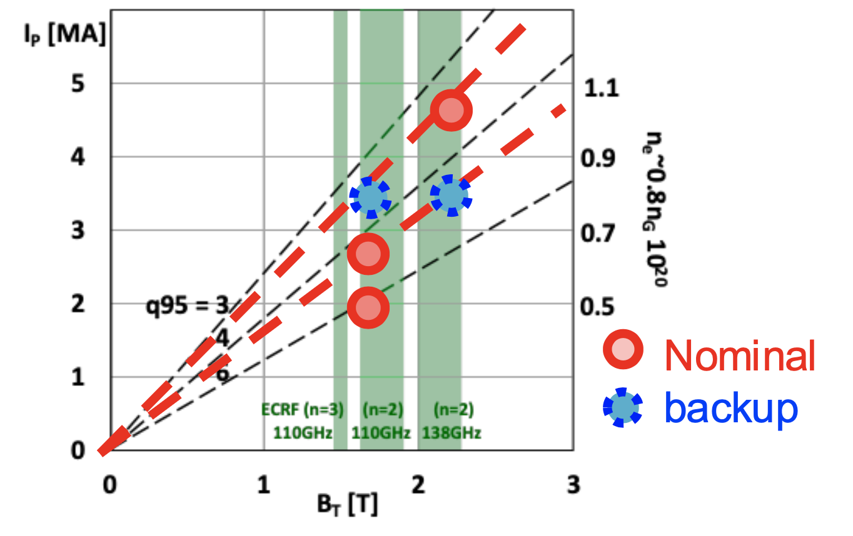
Highlights
Scientific interest on JT-60SA is increasing with the major goals in 2025 achieved with the operation scenario modelling in preparation of the Operation Phase 2 and Operation Phase 3 and for the transition to Tungsten plasma facing components.
Main target scenarios in Operation Phase 2

Slide 11

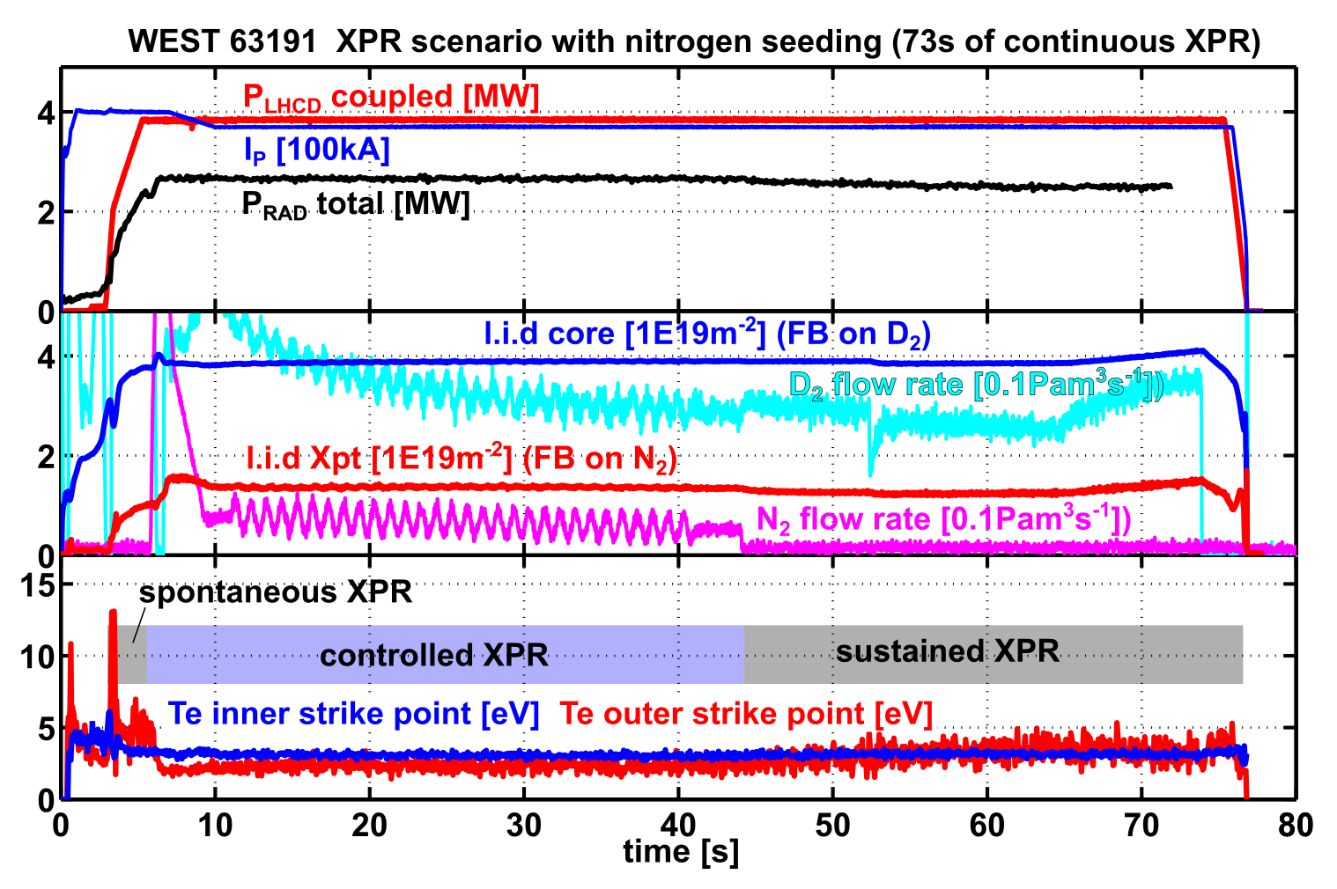

Highlights
High fluence campaign was achieved at low divertor Electron Temperature in WEST. After 4 weeks with repetitive (~70 seconds discharges) reached a particle fluence equivalent to more than an ITER pulse.

Slide 12
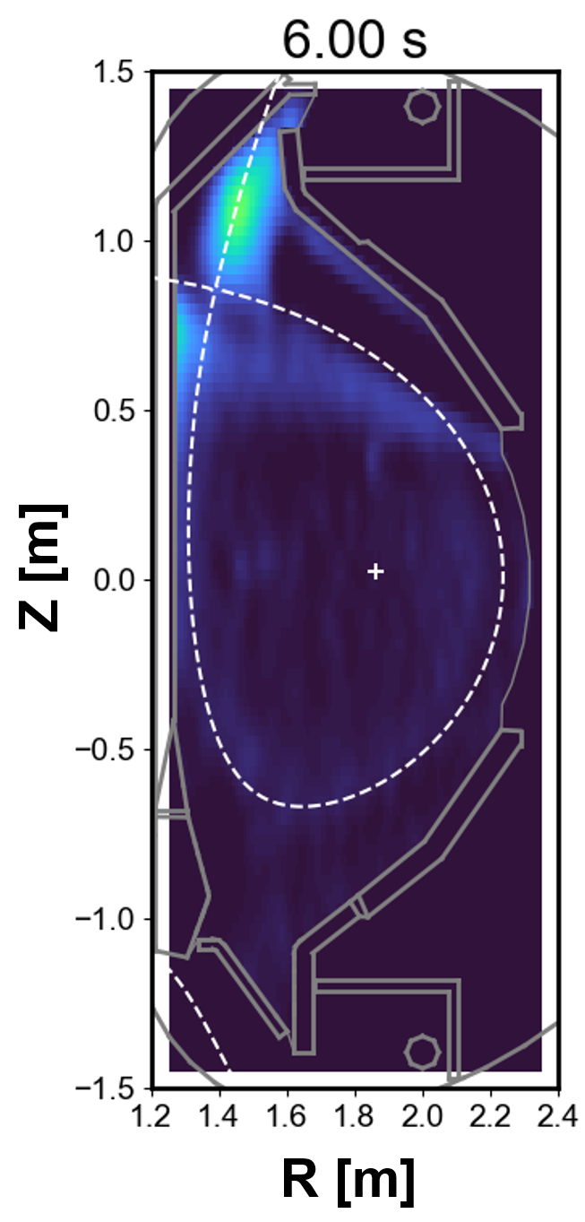
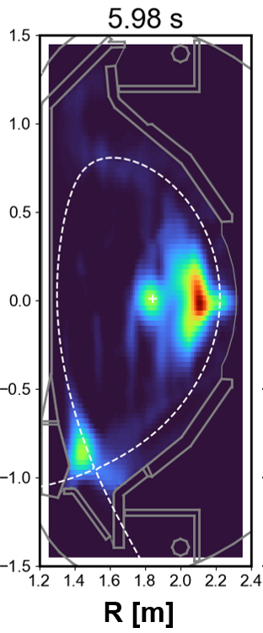

Highlights
In KSTAR the effect of the Tungsten divertor was studied using Lower Single Null / Upper Single Null comparison experiments.

Slide 13
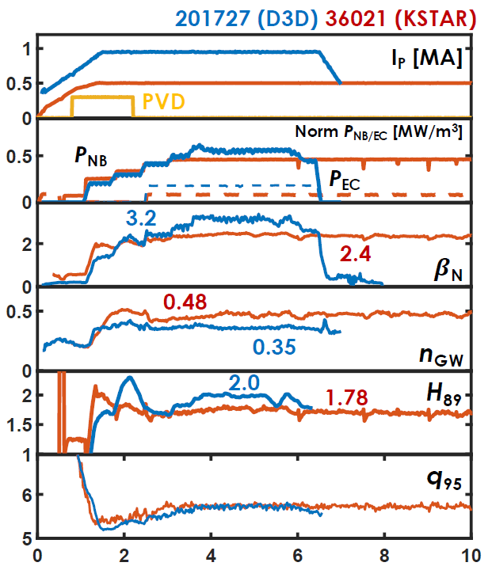

Highlights
DIII-D hybrid scenario optimized for KSTAR in Tungsten environment, showing similar characteristics
The DIII-D hybrid scenario was demonstrated in a Tungsten environment in KSTAR, confirming its long-pulse applicability.

Slide 14

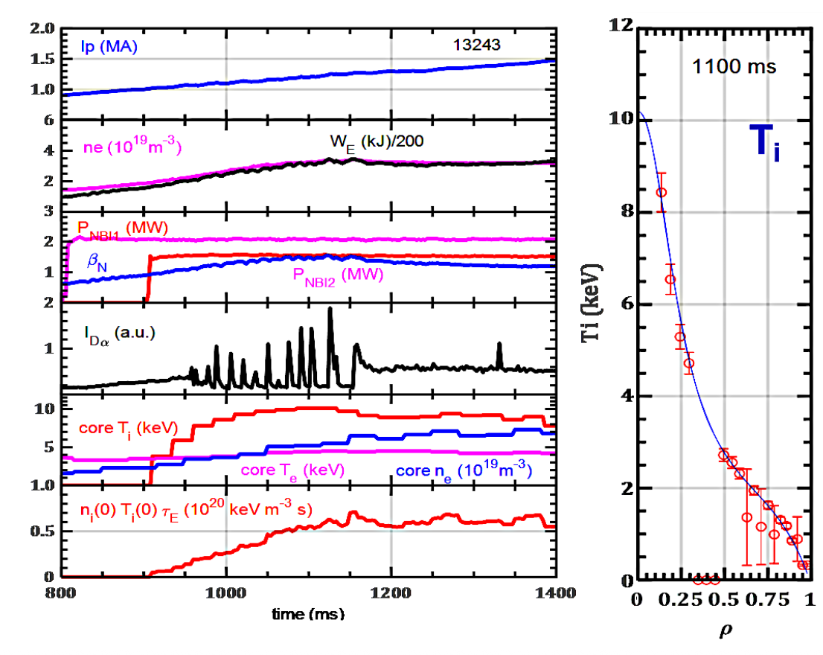


Highlights
EAST achieved double transport barrier operation with a strong ion internal transport barrier with core reversed magnetic shear and an electron transport barrier.

Slide 15
Summary
CTP TCP contributes to maintain and enhance international collaboration between tokamaks.
CTP TCP contributes by supporting ITPEA in providing a legal framework.
CTP TCP contributes to enhancing the participation of the private sector in fusion development.

Slide 16
Thank you for your attention

